Slide 1

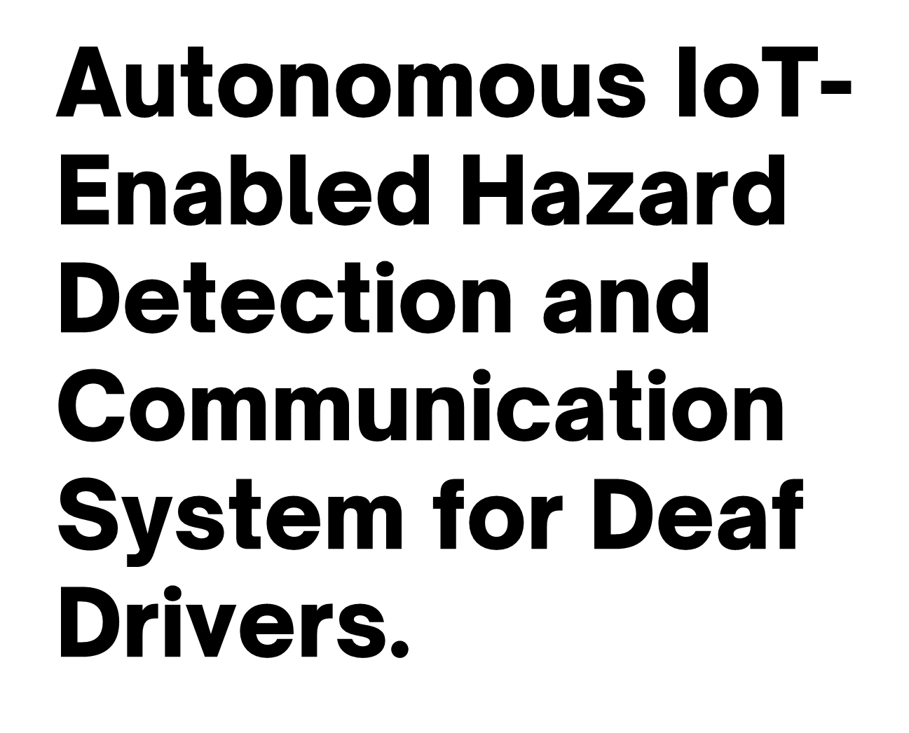
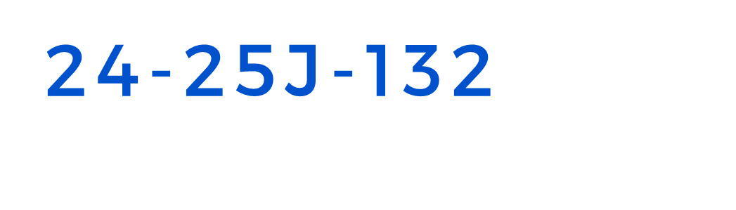

Slide 2

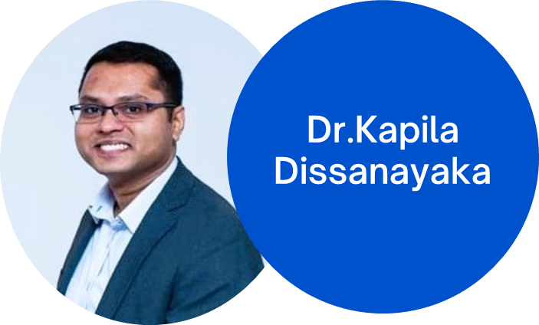
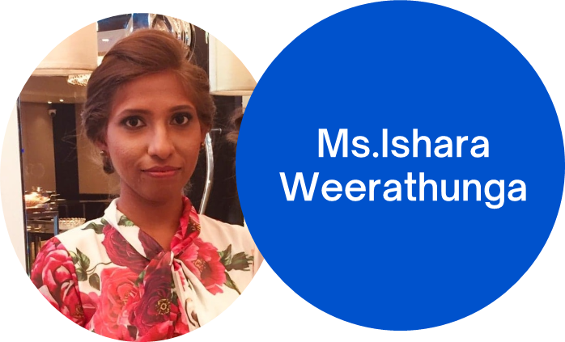
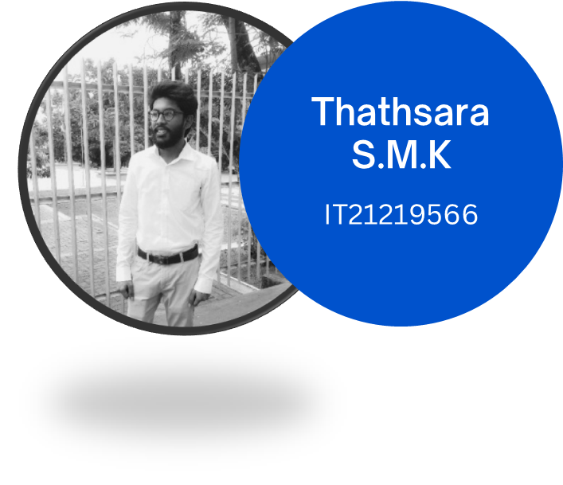
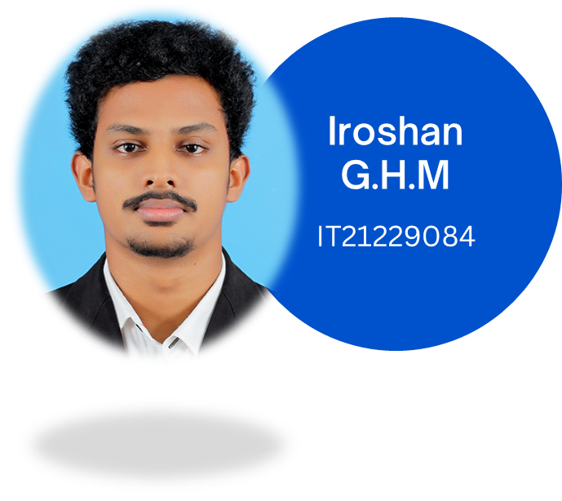
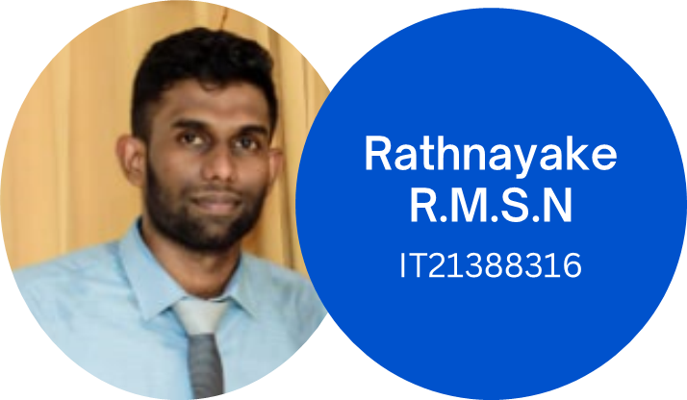
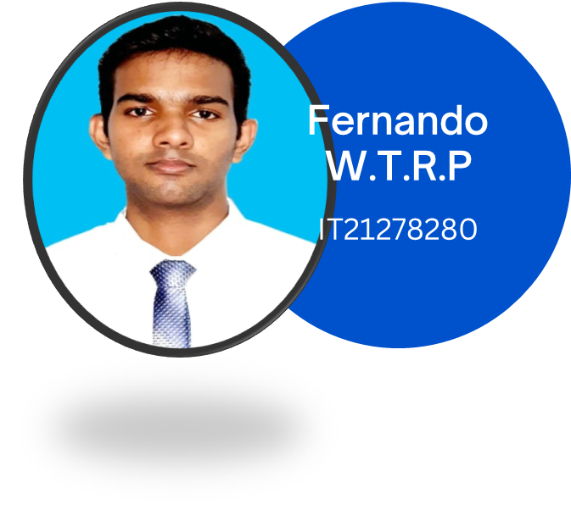
(Supervisor)
(Co-Supervisor)

Slide 3


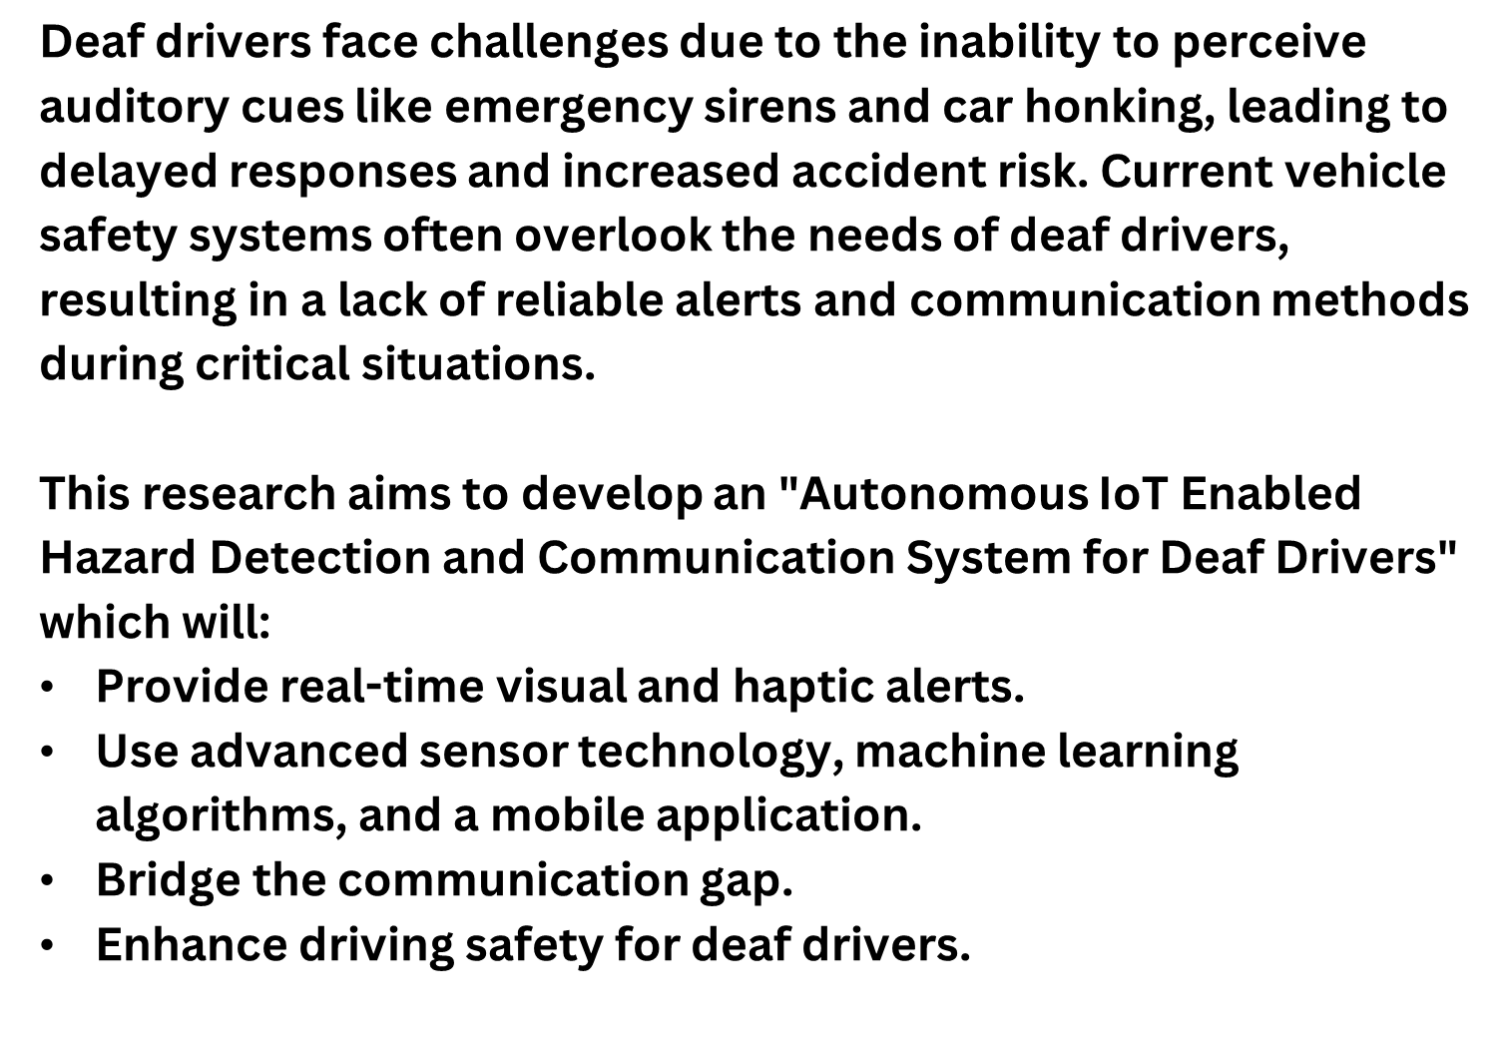

Slide 4
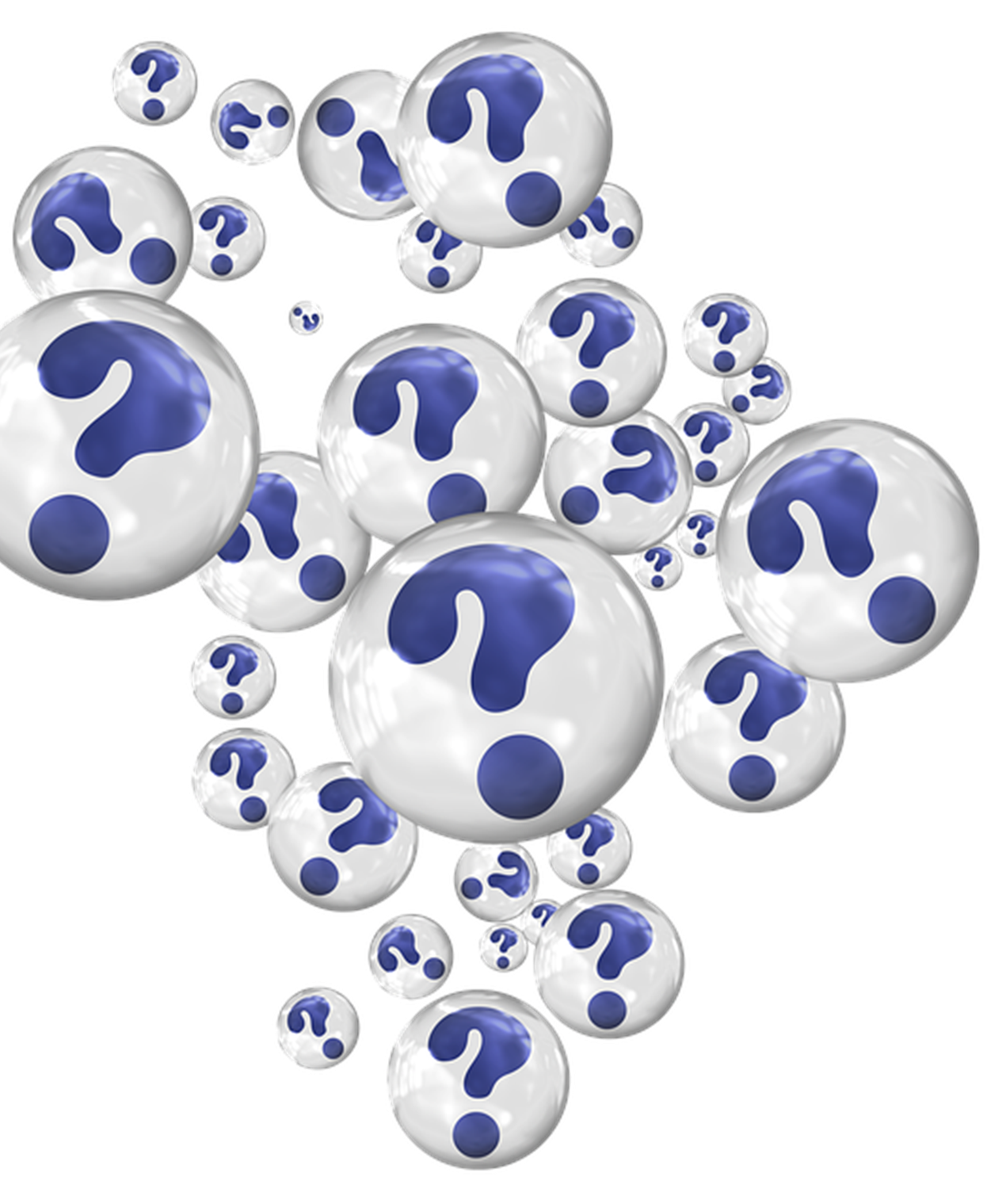

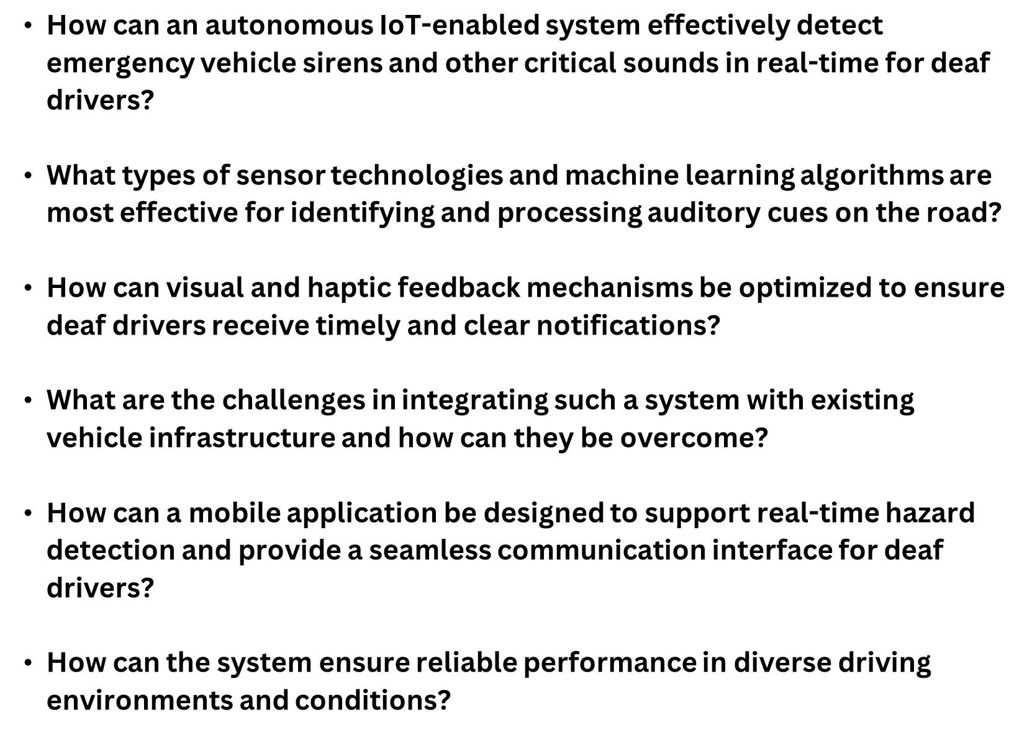

Slide 5







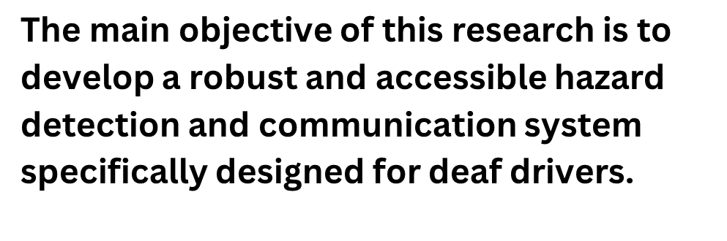
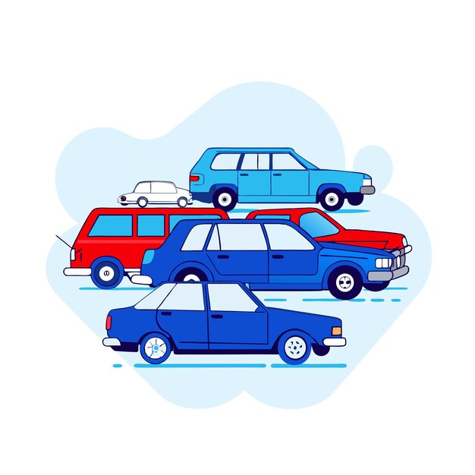

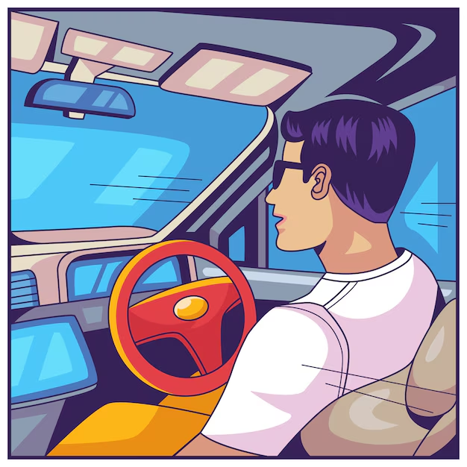

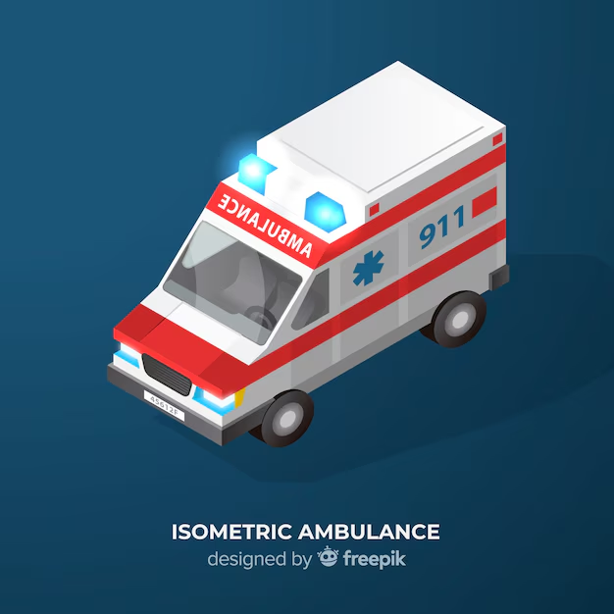


Slide 6
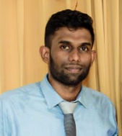

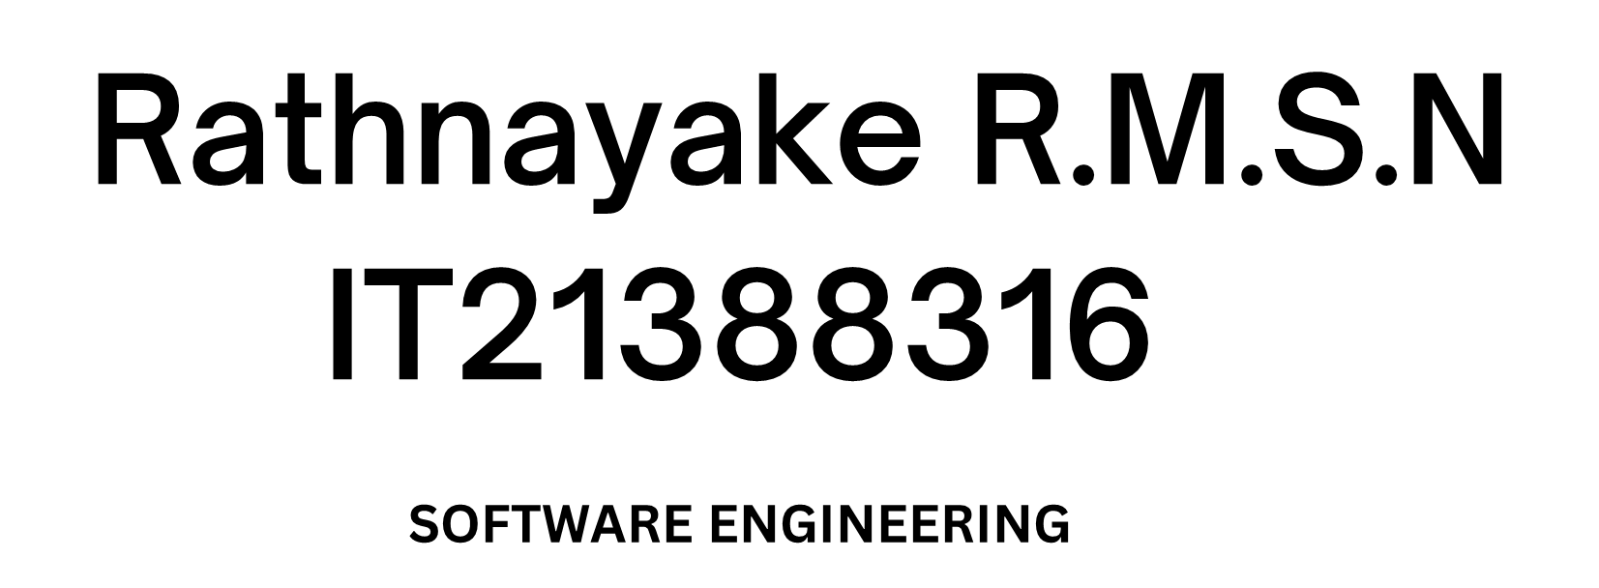
IT21388316 | Rathnayake R.M.S.N | 24-25J-132

Slide 7
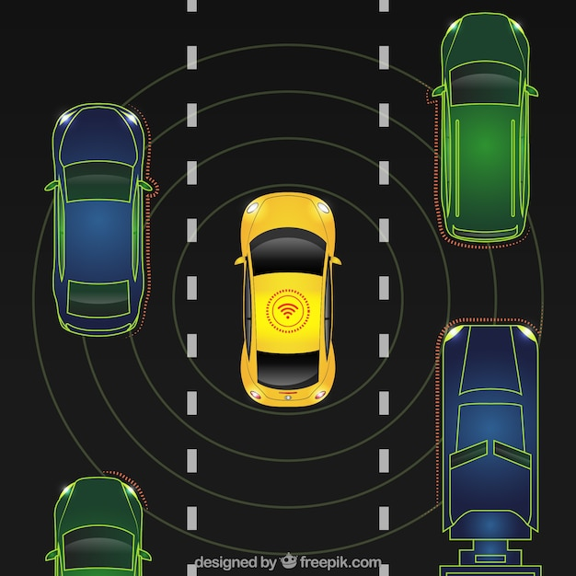
Introduction
Problem: Deaf drivers cannot hear emergency sirens, risking road safety.
Objective: Develop an IoT-based alert system for deaf drivers.
Alert via Visual and Haptic Feedback using a Mobile App and smart band.
IT21388316 | Rathnayake R.M.S.N | 24-25J-132

Slide 8
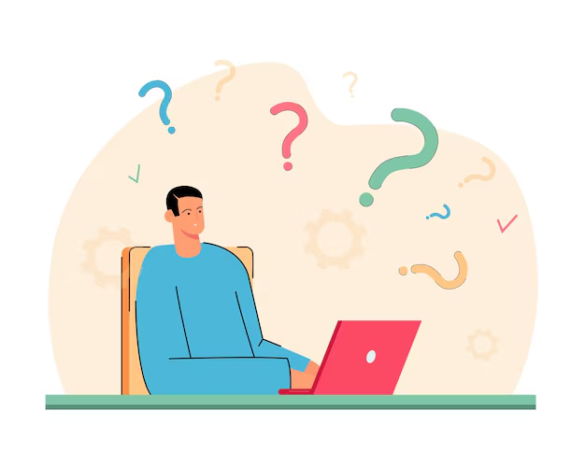
Research Question
How can we develop an effective system to detect and notify deaf drivers of approaching emergency vehicles using advanced sound recognition and real-time alert mechanism?
what are the optimal configurations for a high-sensitive MEMS microphone array to accurately capture emergency vehicle siren sounds amidst traffic noise?
What are the most effective microcontrollers for real-time signal processing and detection in a mobile vehicular environment?
How can seamless and reliable communication be established between the detection unit and notification system via Bluetooth or WiFi modules?
IT21388316 | Rathnayake R.M.S.N | 24-25J-132

Slide 9
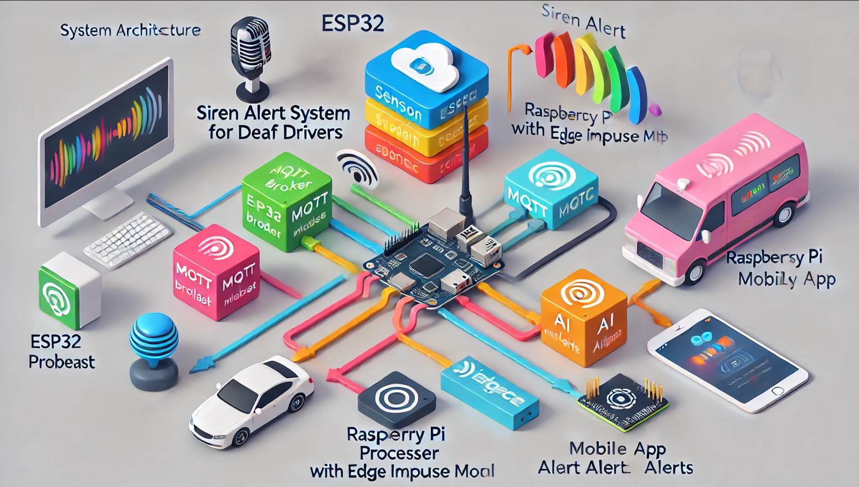
System Overview Diagram
IT21388316 | Rathnayake R.M.S.N | 24-25J-132

Slide 10
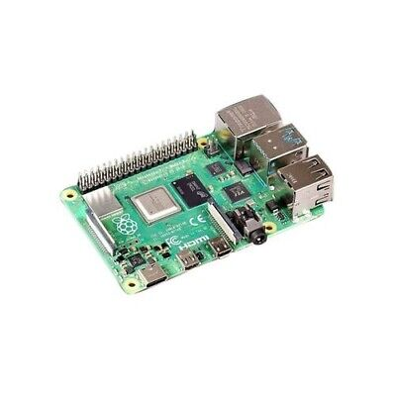
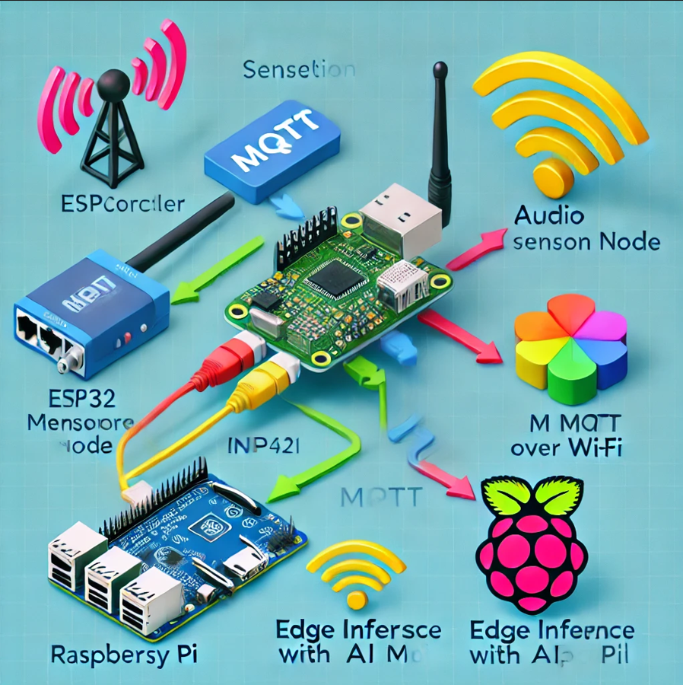
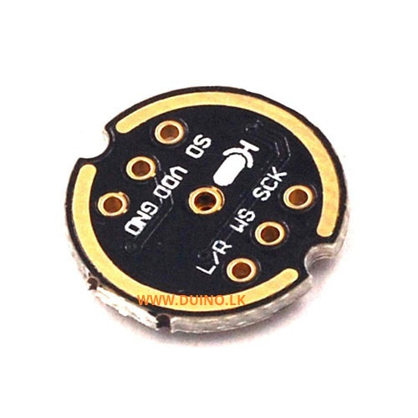
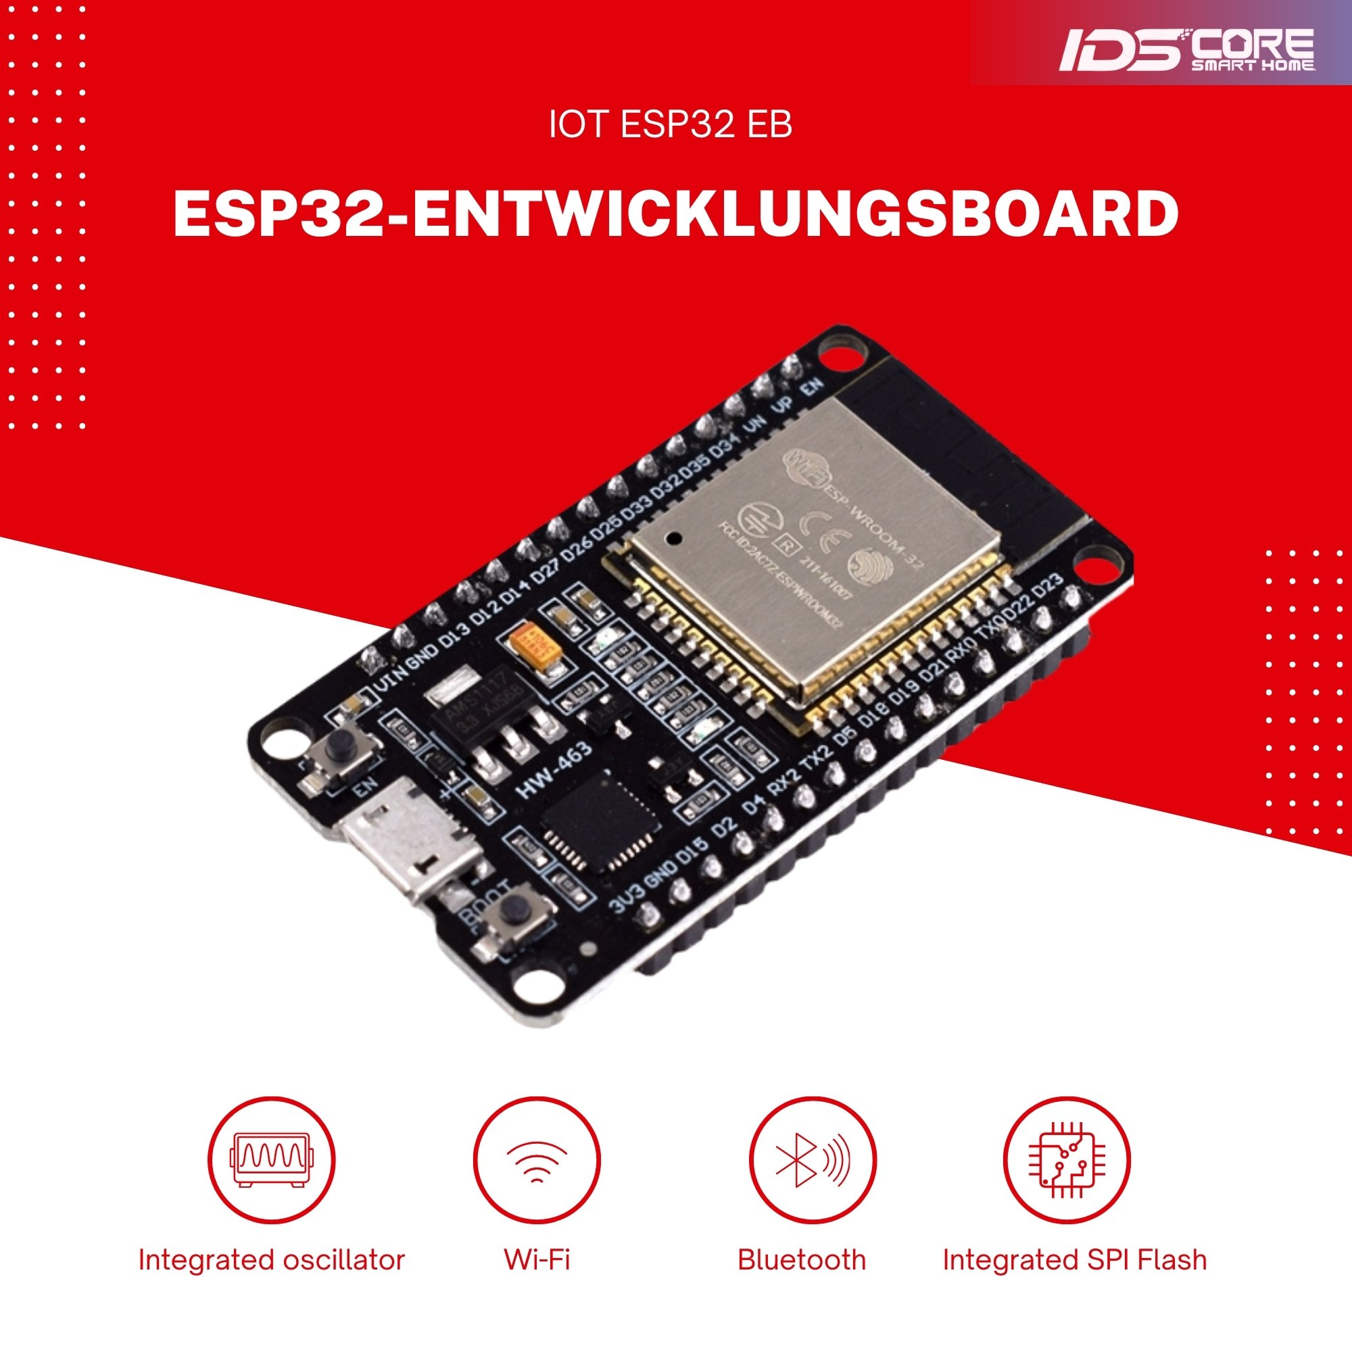
Hardware Architecture
IT21388316 | Rathnayake R.M.S.N | 24-25J-132

Slide 11
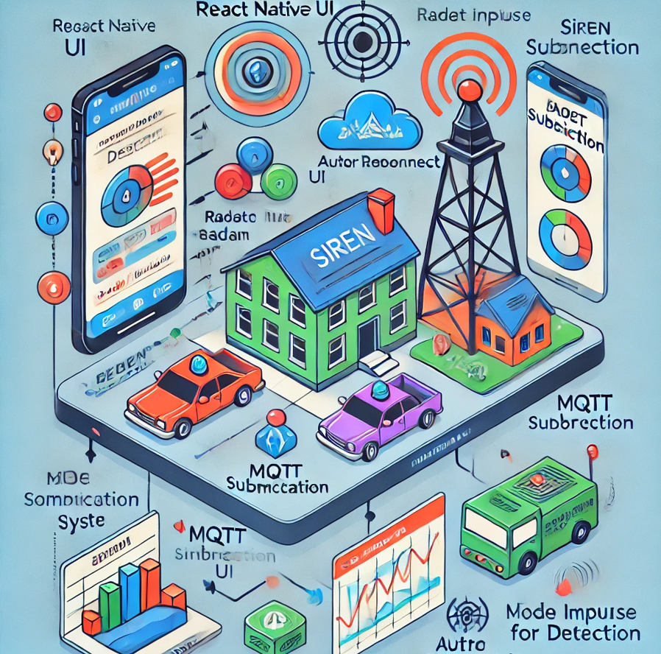
Software Architecture
IT21388316 | Rathnayake R.M.S.N | 24-25J-132

Slide 12
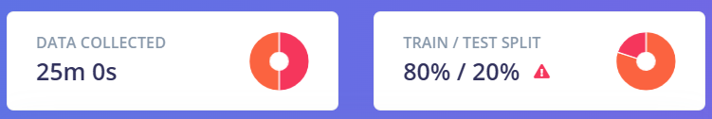
Sources of Audio Data
Pre-existing Datasets
UrbanSound8K: Contains environmental sound clips, including sirens.
Manual Collection
Emergency vehicles like ambulances, police cars, and fire trucks.
Different scenarios (urban, rural, heavy traffic).
Publicly Available Recordings
Extract sounds from YouTube videos.
IT21388316 | Rathnayake R.M.S.N | 24-25J-132

Slide 13
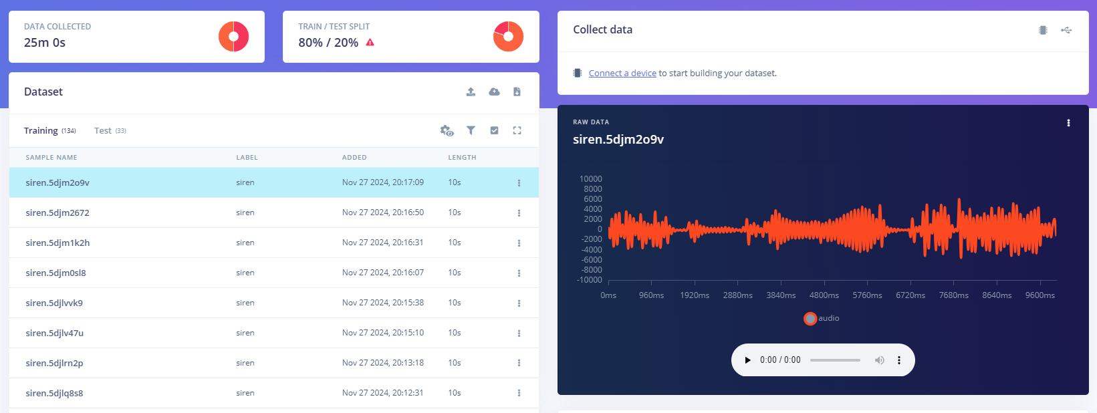
Data Acquisition
IT21388316 | Rathnayake R.M.S.N | 24-25J-132

Slide 14
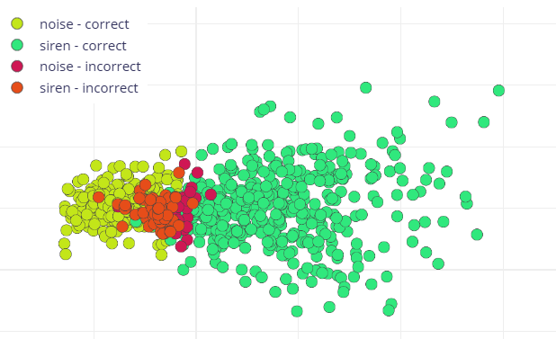
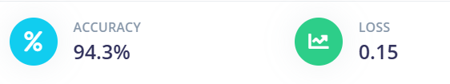
Deep Learning Model
Architecture : Convolutional Neural Network (CNN) architecture
Number of training cycles(epochs) : 300
Training processor : CPU
Add Data augmentation
IT21388316 | Rathnayake R.M.S.N | 24-25J-132

Slide 15
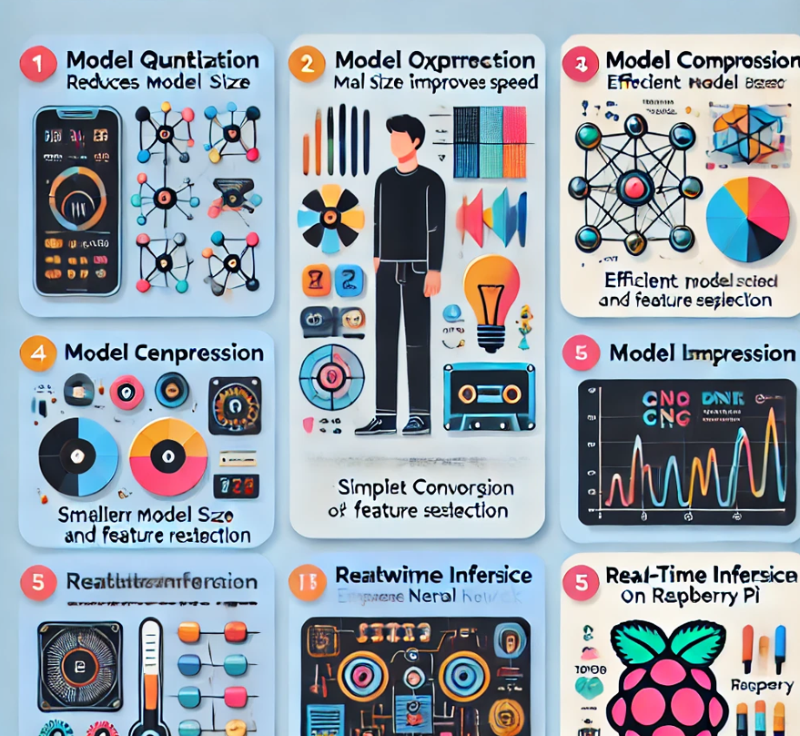
Model Optimization Techniques
Quantization — Reduces size, improves speed
MFCC Features — Efficient audio representation
Model Compression — Smaller, faster model via Edge Impulse
Optimized for Real-Time Inference on Raspberry Pi
IT21388316 | Rathnayake R.M.S.N | 24-25J-132

Slide 16
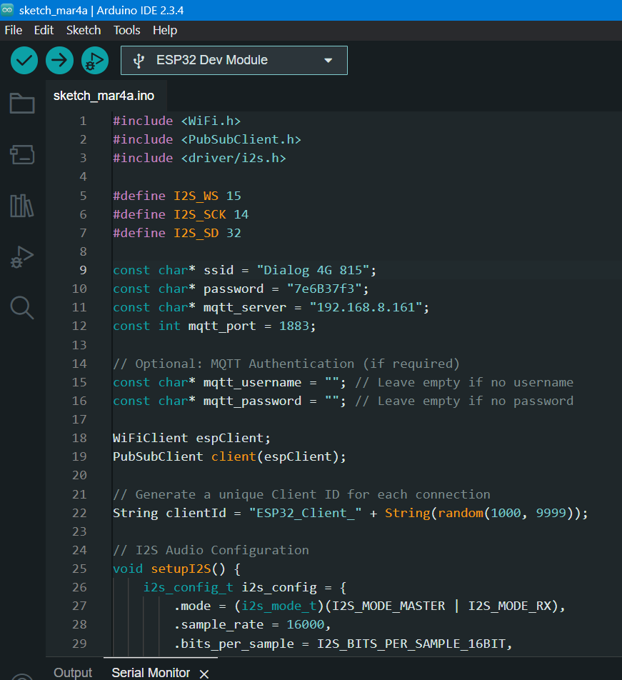
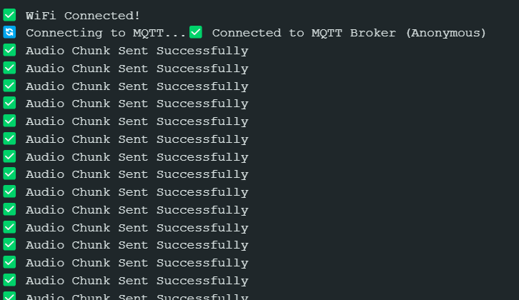
ESP32 Nodemcu Board Processing
IT21388316 | Rathnayake R.M.S.N | 24-25J-132

Slide 17
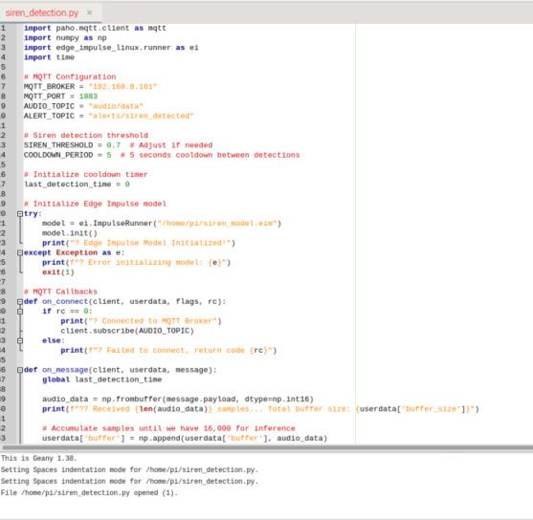
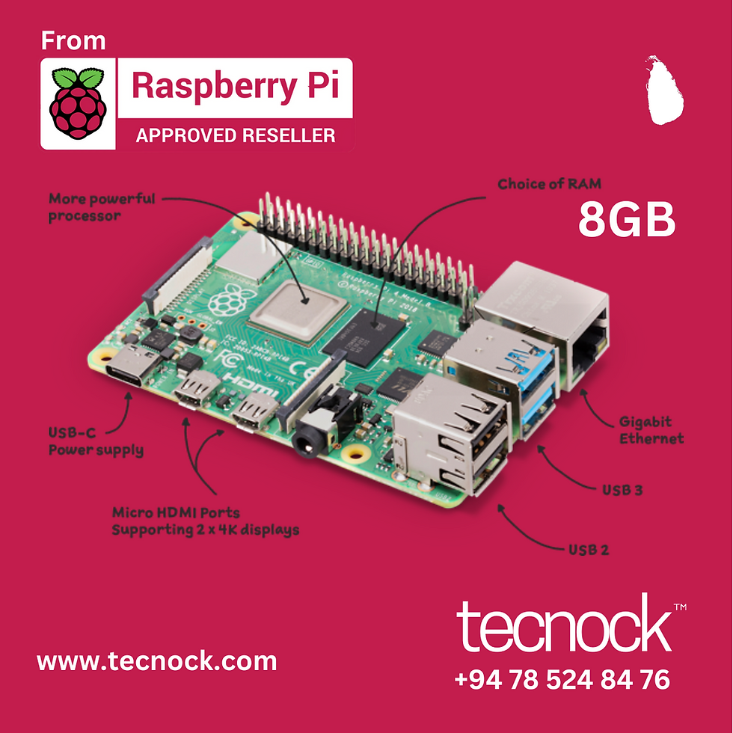
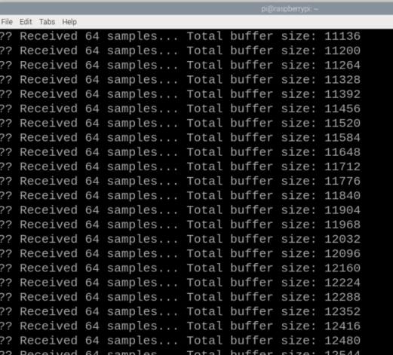
Raspberry pi Board Processing
Siren_detection.py
IT21388316 | Rathnayake R.M.S.N | 24-25J-132

Slide 18
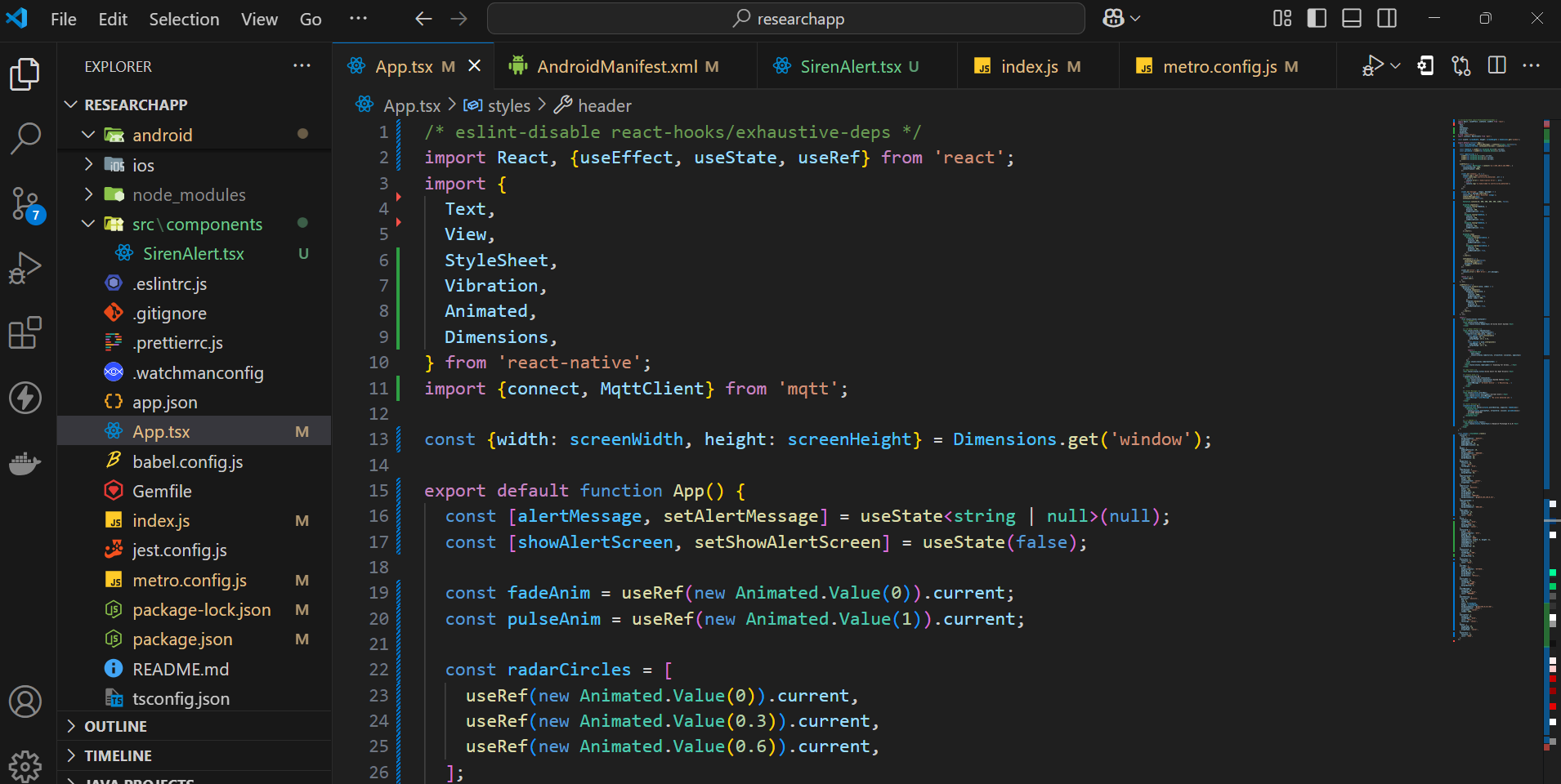
React Native App
IT21388316 | Rathnayake R.M.S.N | 24-25J-132

Slide 19
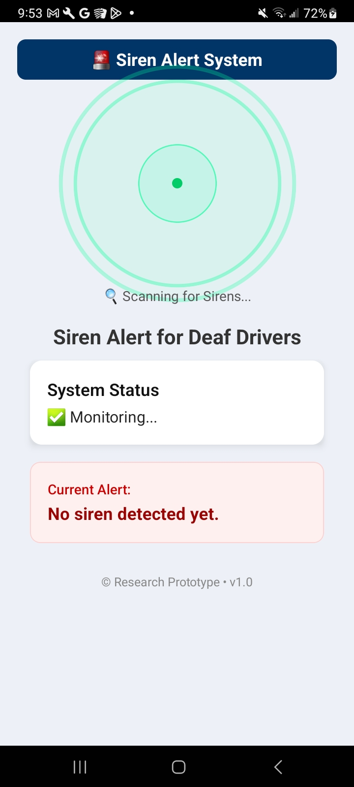
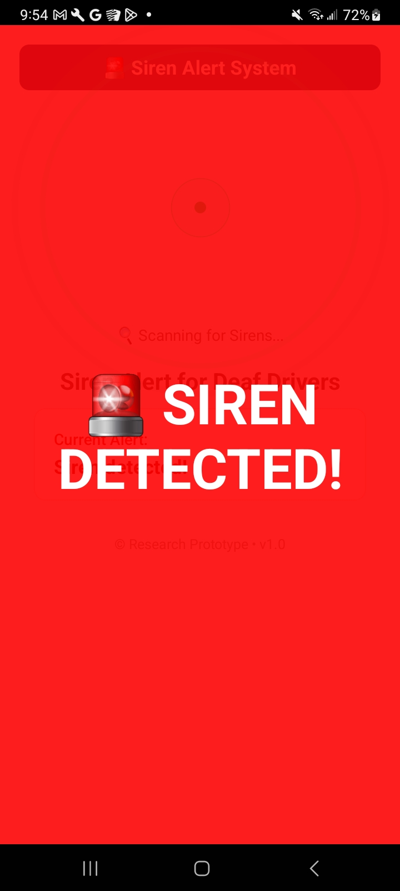
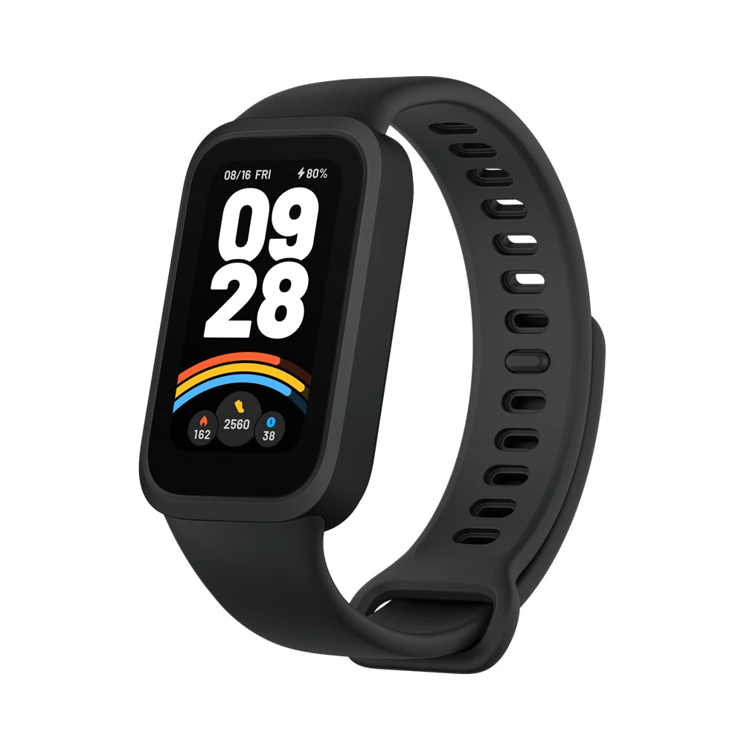
Notification System
IT21388316 | Rathnayake R.M.S.N | 24-25J-132

Slide 20
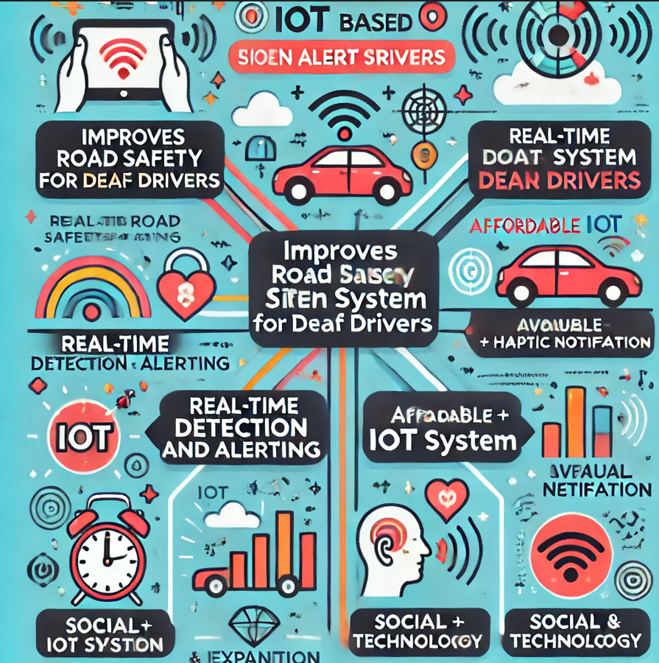
Impact & Benefits
Improves Road Safety for Deaf Drivers
Real-Time Detection and Alerting
Affordable IoT-based System
Scalable and Expandable
Visual + Haptic notification
Social and Technological Impact
IT21388316 | Rathnayake R.M.S.N | 24-25J-132

Slide 21
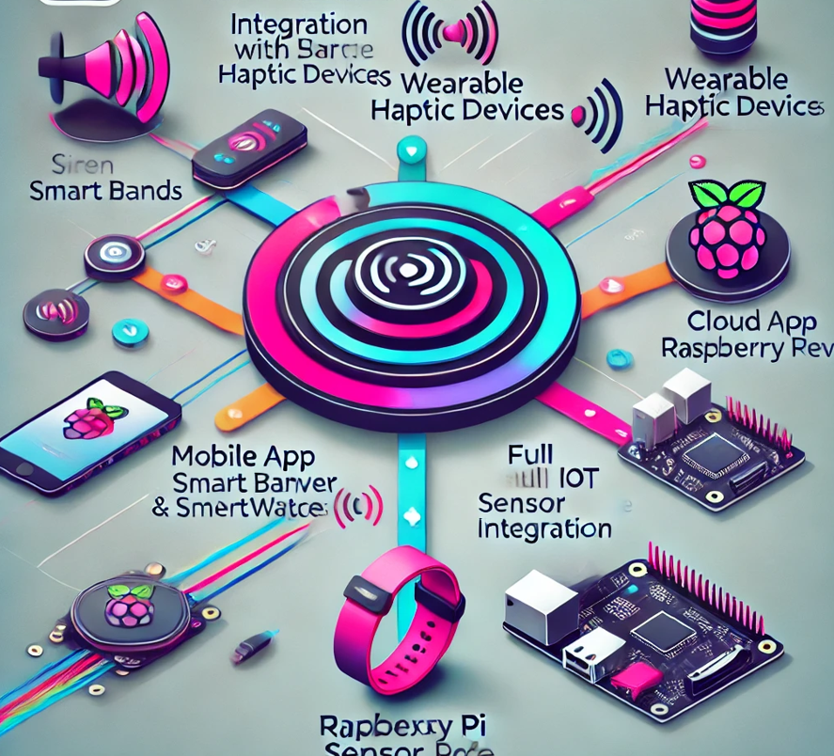
Future Implémentations
Connecting with wearable haptic bands.(smart bands/smartwatches)
Final system integration.
IT21388316 | Rathnayake R.M.S.N | 24-25J-132

Slide 22
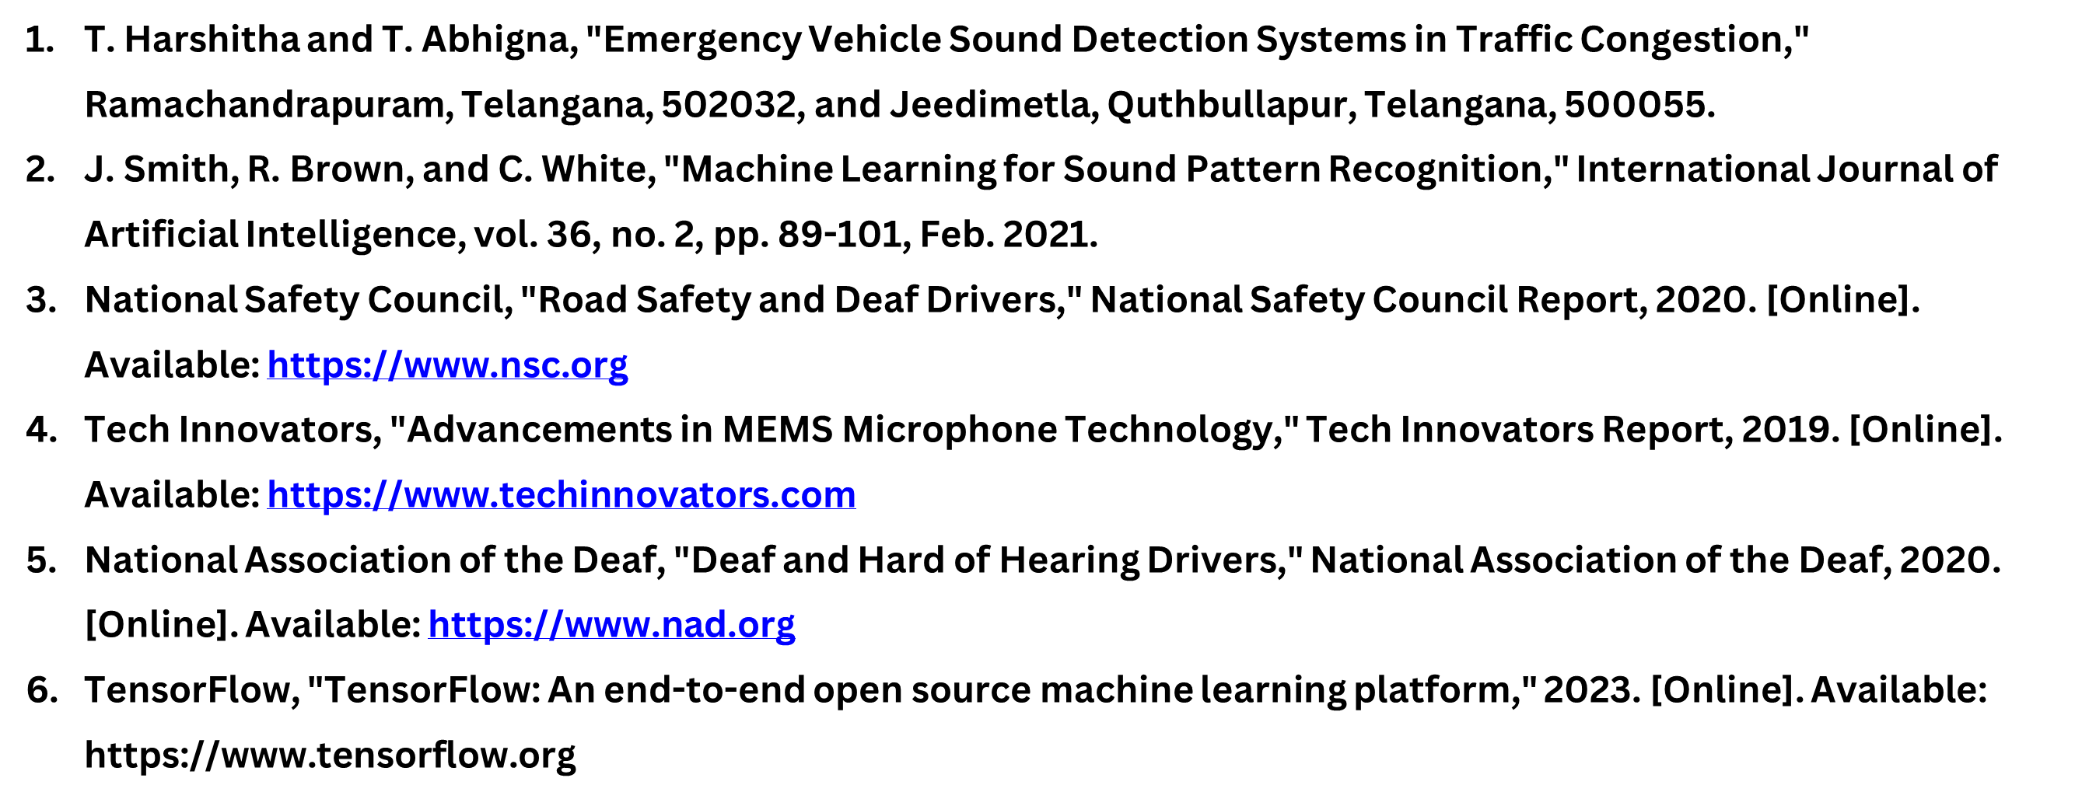
References
IT21388316 | Rathnayake R.M.S.N | 24-25J-132

Slide 23
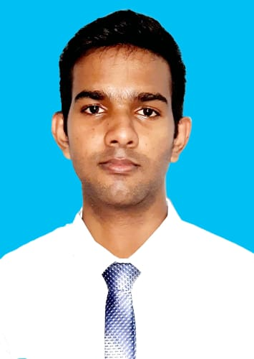
Fernando W.T.R.P
IT21278280
Software Engineering
IT21278280 | Fernando W.T.R.P | 24-25J-132

Slide 24
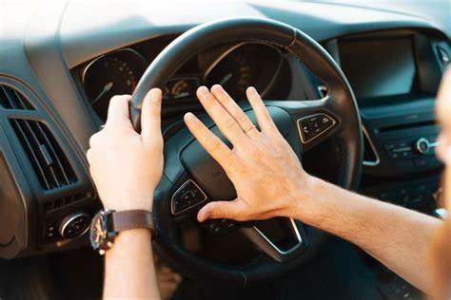
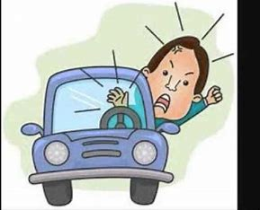
Continued Vehicle Horn Detection and Alert System
IT21278280 | Fernando W.T.R.P | 24-25J-132

Slide 25
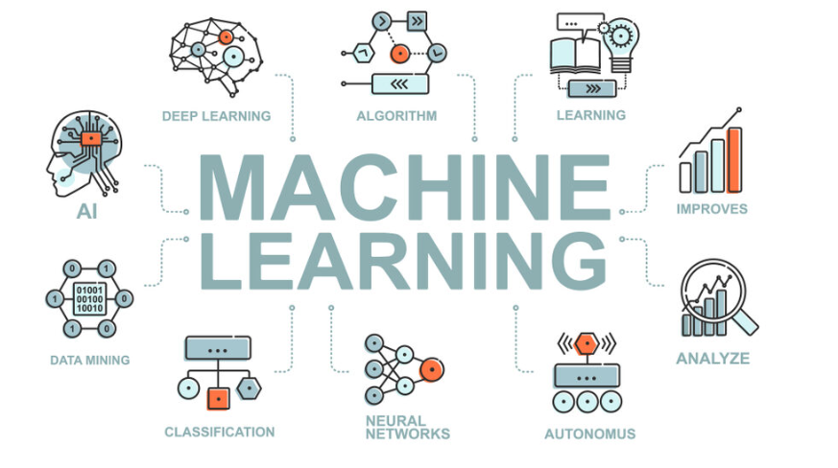
Background
Deaf drivers cannot hear vehicle horns, risking their safety.
Existing systems don't help deaf drivers effectively.
IT21278280 | Fernando W.T.R.P | 24-25J-132

Slide 26

Research Questions
How can we detect and classify horn sounds accurately?
What machine learning methods can separate horn sounds from background noise?
How can we determine the direction of the horn sound using microphones?
What’s the best way to alert deaf drivers using visual & haptic feedback?
IT21278280 | Fernando W.T.R.P | 24-25J-132

Slide 27
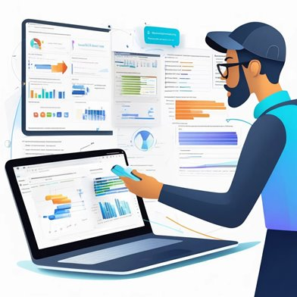
Specific & Sub Objectives
Main Objective
Develop a real-time horn detection system for deaf drivers using machine learning and sound localization.
Specific Objectives
Set up microphones to capture horn sounds.
Use machine learning to classify horn sounds.
Apply TDOA to find the horn's direction.
Build a mobile app for visual & haptic alerts.
Test system accuracy in different traffic conditions.
IT21278280 | Fernando W.T.R.P | 24-25J-132

Slide 28
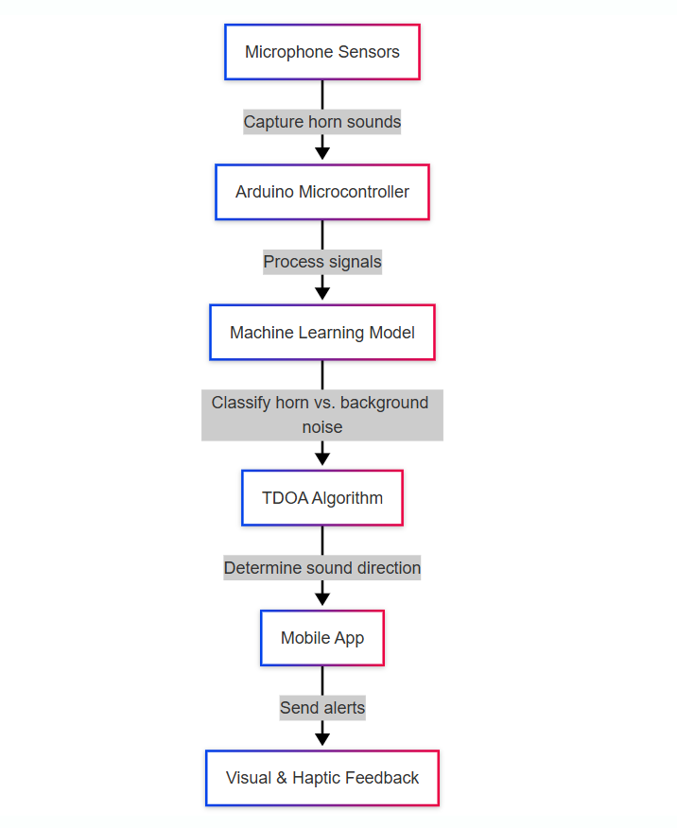
Methodology - System Diagram
IT21278280 | Fernando W.T.R.P | 24-25J-132

Slide 29


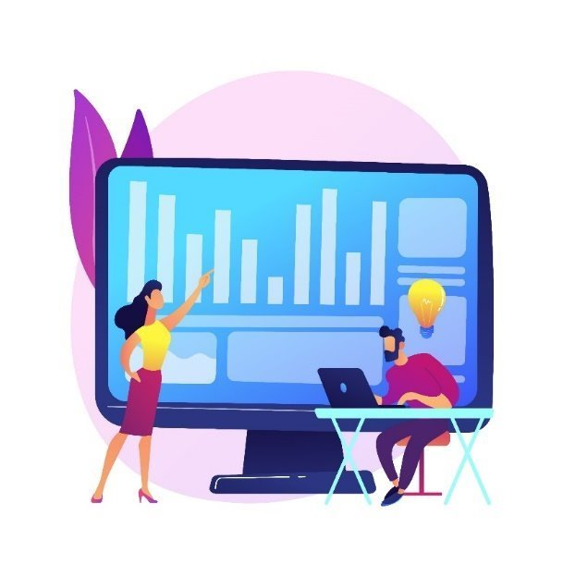
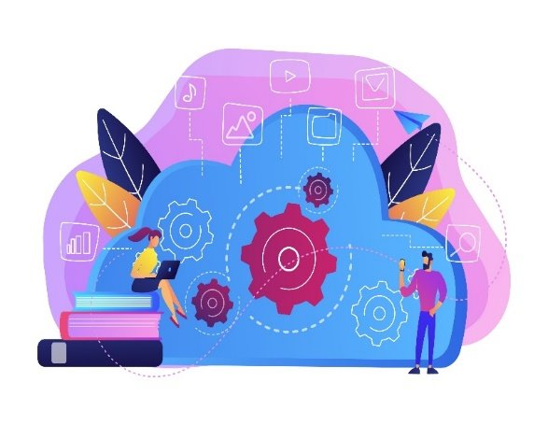
Technologies, Techniques & Algorithms
Technologies
React Native
Arduino Code
VS code
Algorithms & Architectures
Classification Algorithms
Feature Extraction
TDOA
ESP32 Architecture
Techniques
ML
Data Preprocessing
IT21278280 | Fernando W.T.R.P | 24-25J-132

Slide 30


Evidence of Completion - Data Collection and Pre-Processing
IT21278280 | Fernando W.T.R.P | 24-25J-132

Slide 31


Evidence of Completion - Training the Model
IT21278280 | Fernando W.T.R.P | 24-25J-132

Slide 32


Accuracy Measures
IT21278280 | Fernando W.T.R.P | 24-25J-132

Slide 33




Evidence of Completion - Back-End Implementation
IT21278280 | Fernando W.T.R.P | 24-25J-132

Slide 34


Back-End Implementation
IT21278280 | Fernando W.T.R.P | 24-25J-132

Slide 35




Testing using an App
IT21278280 | Fernando W.T.R.P | 24-25J-132

Slide 36

System & Software Specification Requirements
Functional Requirements
Non-Functional Requirements
Horn Detection
Sound Localization
Real Time Alerts
Accuracy
User-Friendly
IT21278280 | Fernando W.T.R.P | 24-25J-132

Slide 37

Completion & Future Works
Completion of the Components
Collect Audio data sets
Audio Classification Model
UI Development
Future Implementations
Improve Sound Localization Algorithm
Testing Alert System
IT21278280 | Fernando W.T.R.P | 24-25J-132

Slide 38



Proof of Completion
IT21278280 | Fernando W.T.R.P | 24-25J-132

Slide 39

Proof of Completion
IT21278280 | Fernando W.T.R.P | 24-25J-132

Slide 40


Proof of Completion
Arduino Serial Monitor
IT21278280 | Fernando W.T.R.P | 24-25J-132

Slide 41

Proof of Completion
Arduino Serial Monitor
IT21278280 | Fernando W.T.R.P | 24-25J-132

Slide 42

Proof of Completion
Arduino Serial Monitor
IT21278280 | Fernando W.T.R.P | 24-25J-132

Slide 43


Correction Points noted from PP1
IT21278280 | Fernando W.T.R.P | 24-25J-132

Slide 44

References
IT21278280 | Fernando W.T.R.P | 24-25J-132

Slide 45

Thathsara S. M. K.
IT21219566
Software Engineering
IT21219566 | Thathsara S. M. K. | 24-25J-132

Slide 46

Comprehensive Driver Behavior Monitoring System.
IT21219566 | Thathsara S. M. K. | 24-25J-132

Slide 47
Background
Multimodal Approaches in Driver Behavior Analysis:
CNN for Visual Inputs
Purpose: Process spatial information from video or image data.
Model Architecture: CNNs for video sequences to capture spatiotemporal features.
RNN for Temporal Sensor Data
Purpose: Handle sequential data such as time-series signals.
Model Architecture: LSTMs (Long Short-Term Memory) for long-range temporal dependencies.
IT21219566 | Thathsara S. M. K. | 24-25J-132

Slide 48

System Diagram
IT21219566 | Thathsara S. M. K. | 24-25J-132

Slide 49

Data Collection
Driver behavior data was collected from Google, Kaggle.
https://www.kaggle.com/competitions/state-farm-distracted-driver-detection
IT21219566 | Thathsara S. M. K. | 24-25J-132

Slide 50

Data Preprocessing
10 Data classes
Normal driving
Texting on right hand
Talking on the phone right hand
Texting on left hand
Talking on the phone left hand
Operating the radio
Drinking / eating
Reaching behind
Hair and makeup
Talking to the passenger
IT21219566 | Thathsara S. M. K. | 24-25J-132

Slide 51


Model Training
IT21219566 | Thathsara S. M. K. | 24-25J-132

Slide 52


Model Accuracy
IT21219566 | Thathsara S. M. K. | 24-25J-132

Slide 53


Model Deployment
IT21219566 | Thathsara S. M. K. | 24-25J-132

Slide 54

Model Deployment
Docker container that includes an HTTP interface to run the model.
IT21219566 | Thathsara S. M. K. | 24-25J-132

Slide 55


Database Configuration
IT21219566 | Thathsara S. M. K. | 24-25J-132

Slide 56
References
A. Alamri, A. Gumaei, M. Al-Rakhami, M. M. Hassan, M. Alhussein and G. Fortino, "An Effective Bio-Signal-Based Driver Behavior Monitoring System Using a Generalized Deep Learning Approach," in IEEE Access, vol. 8, pp. 135037-135049, 2020, doi: 10.1109/ACCESS.2020.3011003.
Qu, Fangming & Dang, Nolan & Furht, Borko & Nojoumian, Mehrdad. (2024). Comprehensive study of driver behavior monitoring systems using computer vision and machine learning techniques. Journal of Big Data. 11. 10.1186/s40537-024-00890-0.
H. -B. Kang, "Various Approaches for Driver and Driving Behavior Monitoring: A Review," 2013 IEEE International Conference on Computer Vision Workshops, Sydney, NSW, Australia, 2013, pp. 616-623, doi: 10.1109/ICCVW.2013.85. keywords: {Vehicles;Feature extraction;Monitoring;Accidents;Visualization;Head;Wheels;Driver drowsiness monitoring;Driving behavior monitoring;Unsafe driving behavior prediction},
V. Sanjay Kumar, S. Nair Ashish, I.V. Gowtham, S.P. Ashwin Balaji, E. Prabhu, Smart driver assistance system using raspberry pi and sensor networks, Microprocessors and Microsystems, Volume 79, 2020, 103275, ISSN 0141-9331,
Sameer Rafee, Xu Yun, Zhang Jian Xin and Zaid Yemeni, “Eye-movement Analysis and Prediction using Deep Learning Techniques and Kalman Filter” International Journal of Advanced Computer Science and Applications(IJACSA), 13(4), 2022. http://dx.doi.org/10.14569/IJACSA.2022.01304107
IT21219566 | Thathsara S. M. K. | 24-25J-132

Slide 57

Iroshan G.H.M
IT21229084
Software Engineering
IT21229084 | Iroshan G.H.M | 24-25J-132

Slide 58

IT21229084 | Iroshan G.H.M | 24-25J-132

Slide 59

LipAssist is a lip-reading model designed to assist the deaf and hard-of-hearing community
It uses deep learning to interpret lip movements and convert them into text.
This project focuses on developing an accurate and accessible lip-reading model using deep learning.
IT21229084 | Iroshan G.H.M | 24-25J-132

Slide 60


How can deaf drivers share emergency details effectively without spoken communication?
What delays do deaf drivers face in getting help during emergencies?
How do stressful situations worsen communication barriers for deaf drivers?
What gaps exist in current methods used by deaf individuals during emergencies?
IT21229084 | Iroshan G.H.M | 24-25J-132

Slide 61


Specific Objective
Sub Objective
To create a real-time lip-reading tool that helps deaf drivers understand spoken instructions during emergencies, ensuring safety and clear communication.
Communication Facilitation
lip reading model
Emergency scenarios
Offline Capability
IT21229084 | Iroshan G.H.M | 24-25J-132

Slide 62

IT21229084 | Iroshan G.H.M | 24-25J-132

Slide 63



Data collection
Alignments
Dataset
IT21229084 | Iroshan G.H.M | 24-25J-132

Slide 64

Alignment Data Visualization
IT21229084 | Iroshan G.H.M | 24-25J-132

Slide 65



Video Frame Data Representation & Predictions
IT21229084 | Iroshan G.H.M | 24-25J-132

Slide 66


Model Architecture Summary
IT21229084 | Iroshan G.H.M | 24-25J-132

Slide 67




Backend Implementation
IT21229084 | Iroshan G.H.M | 24-25J-132

Slide 68


Testing Using A WebApp
IT21229084 | Iroshan G.H.M | 24-25J-132

Slide 69

Future Implémentations
Audio-Visual Fusion
Larger Datasets
Cross-Language Support
Improved Model Architectures
IT21229084 | Iroshan G.H.M | 24-25J-132

Slide 70

[1] Buzzi, M. C., et al. "A Comprehensive Survey of Enabling Technologies for Deaf People." Journal of Ambient Intelligence and Smart Environments 10.6 (2018): 497-518. https://doi.org/10.1016/j.jatar.2023.04.015.
[2] Jaiswal, D., et al. "Assistive Technology for Deaf: A Systematic Literature Review." Universal Access in the Information Society 20 (2021): 333-356. https://link.springer.com/article/10.1007/s10209-020-00762-1.
[3] Palanisamy, B., et al. "Mobile Computing: Challenges in Real-Time Location-Based Service and Solutions." IEEE Communications Surveys & Tutorials 15.1 (2013): 443-461. https://ieeexplore.ieee.org/document/6232247.
[4] Chen, L., et al. "A Survey of Sensing and Localization in Internet of Things for Smart Cities." IEEE Internet of Things Journal 7.1 (2020): 9-27.
https://ieeexplore.ieee.org/document/8771450.
[5] Fang, H., et al. "Recent Advances in Deep Learning for Speech Synthesis: A Survey." IEEE/ACM Transactions on Audio, Speech, and Language Processing 27.8 (2019): 1282-1304. https://ieeexplore.ieee.org/document/8707065.
[6] Buzzi, M. C., Leporini, B., & Akhter, F. "Assistive Technology for Deaf and Hard of Hearing People: Real Time Text and Sign Language." Proceedings of the 16th International ACM SIGACCESS Conference on Computers & Accessibility (2014): 263-264. https://www.sciencedirect.com/science/article/pii/S1084804516300652
IT21229084 | Iroshan G.H.M | 24-25J-132
Notes:
L

